Slide 1
Cloud-native applications

Slide 2
Step 1: Review the customer case study
Outcome
Analyze your customer needs.

Slide 3
Customer situation
Fabrikam Medical Conferences provides conference web site services tailored to the medical community.
After starting with a few small conferences, they now have evolved into a well-known brand and handle over 100 conferences per year, and growing.

Slide 4
Customer situation
Each conference site has limited budget, but the conference owners have significant customization and change demands.
These changes can impact various aspects of the system from UI to back end, including conference registration and payment terms.

Slide 5
Customer situation
12 developers handle
Development
Testing
Deployment
Operational management of all customer sites
Due to customer demands, they have issues with the efficiency and reliability of their development and DevOps workflows.

Slide 6
Customer situation
The technology used is the MEAN stack
Mongo, Express, Angular, and Node.js
Web sites and APIs are built as microservices hosted on Linux servers.
The on-prem data backend is MongoDB; also running on a separate cluster of Linux servers.
There is relational data stored in PostgreSQL running on Linux servers.

Slide 7
Customer situation
Conference owners (“customers”) are considered “tenants”, and each tenant is treated as a unique deployment including:
Each tenant has a database in the MongoDB cluster with its own collections, and a database in PostgreSQL.
A copy of the most recent functional conference code base is taken and configured to point at the tenant database
Modifications are made to support the customer’s needs
The tenant’s code is deployed to a specific group of load balanced Linux server dedicated to one or more tenant.
Once the conference site is live, the inevitable requests for customizations to the deployment begins.

Slide 8
Customer situation
They are looking to achieve the following:
Reduce potential regressions introduced to functional tenant code when changes are made
Ideally, changes to individual areas should not require a full regression test of the site functionality
Reduce the time to onboard new tenants
Reduce overhead managing changes, and related deployments
Improve ability to roll back and recover post change
Increase visibility into system operations and health

Slide 9
Customer needs
Simplify new tenant deployment
Improve reliability of tenant updates
Choose a suitable container strategy on Azure
Migrate on-prem MongoDB to cloud without application changes
Migrate on-prem PostgreSQL to cloud
Continue to use Git repositories for source control
Look at alternatives for CICD

Slide 10
Customer needs
Evaluate tools for deployment, CICD integration, container scheduling, orchestration, monitoring, and alerts
They wish to complete an implementation of the proposed solution for a single tenant to train the team and perfect the process
Enhance attendee session feedback with AI to prevent inappropriate content from being posted, and real-time language translation to better accommodate growing worldwide conference attendance.

Slide 11
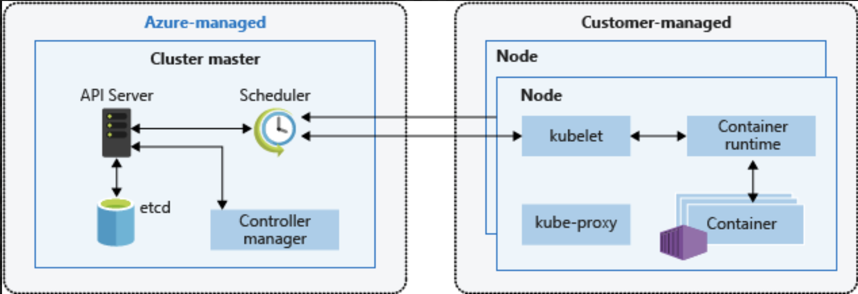
Kubernetes Architecture (AKS)

Slide 12
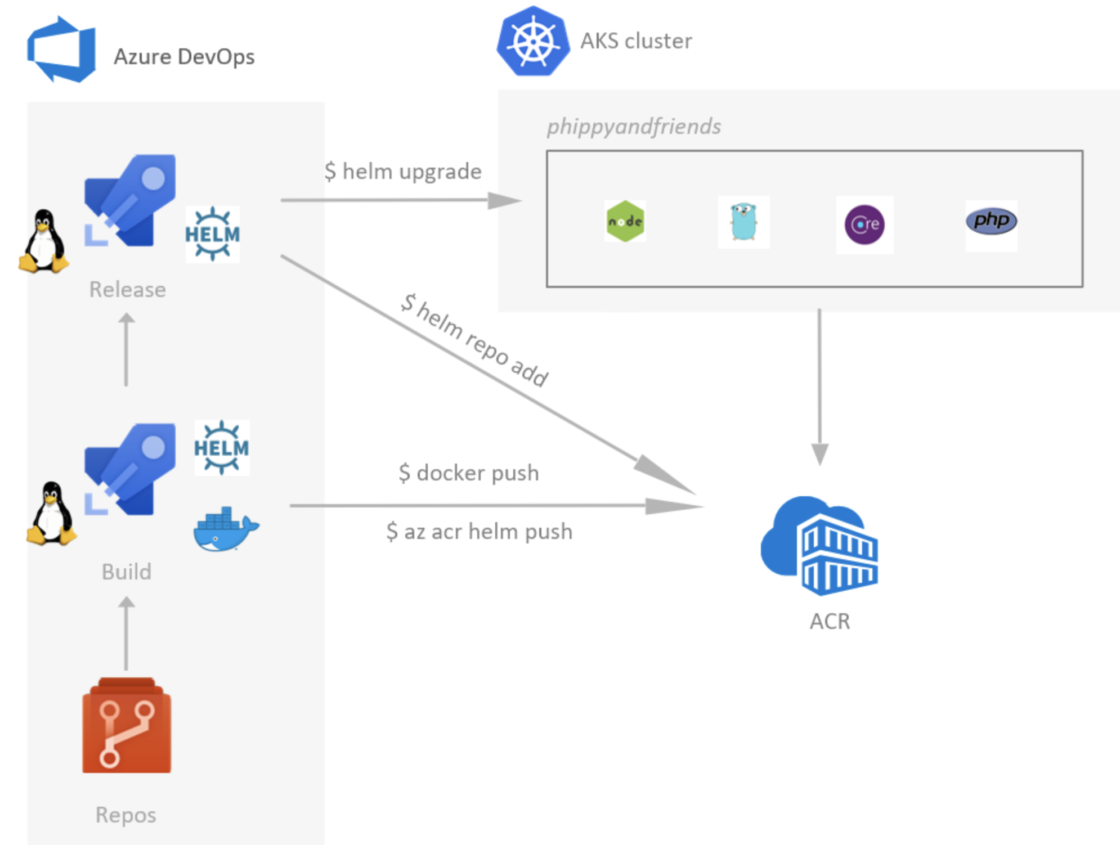
Azure DevOps for CICD to Azure Kubernetes Service (AKS)

Slide 13
Preferred solution
After evaluating the options for container platforms on Azure, Fabrikam Medical Conferences decided to move forward with Azure Kubernetes Service (AKS).
They also decided to move forward with GitHub Actions for infrastructure and container DevOps workflows.

Slide 14
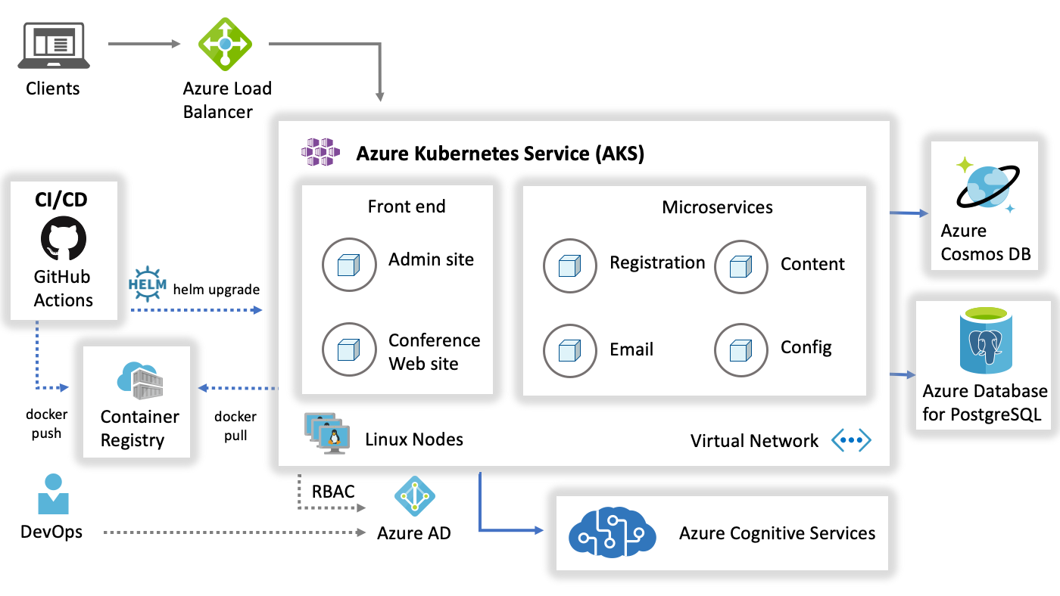
Preferred solution
Notes:
Reference Links:
https://docs.microsoft.com/en-us/azure/architecture/reference-architectures/microservices/aks

